Slide 1

SDF II(15B11CI211) EVEN Semester 2021
2nd Semester , First Year
Jaypee Institute Of Information Technology (JIIT), Noida

Slide 2
Topics Covered
Data vs. Information
Database and its Application
Database Management System
File based system and its Drawback
Advantages of Database management System
Types of DBMS
Relational DBMS

Slide 3
Data vs. Information
What is data?
Data can be defined in many ways. Information science defines data as unprocessed information.
Eg:-names, telephone numbers etc.
What is information?
Information is data that have been organized and communicated in a coherent and meaningful manner.
Data is converted into information, and information is converted into knowledge.
Knowledge; information evaluated and organized so that it can be used purposefully.
Notes:
Data are the raw bits and pieces of information with no context. If I told you, “15, 23, 14, 85,” you would not have learned anything. But I would have given you data.
Data can be quantitative or qualitative. Quantitative data is numeric, the result of a measurement, count, or some other mathematical calculation. Qualitative data is descriptive. “Ruby Red,” the color of a 2013 Ford Focus, is an example of qualitative data.

Slide 4
Database - Definition
A database is any organized collection of data. Some examples of databases you may encounter in your daily life are:
a telephone book
T.V. Guide
airline reservation system
Universities
Credit card transactions
files on your computer hard drive
Other Definitions :
A database represents some aspects of the real world , sometimes called the miniworld. Changes to the miniworld are reflected in the data base
A database is a logically coherent collection of data with some inherent meaning.
A data base is designed , built and populated with data for a specific purpose. It has an intended group of users and some preconceived applications in which these users are interested.

Slide 5
Why do we need a database?
Keep records of our:
Clients
Staff
Volunteers
To keep a record of activities and interventions
Keep sales records
Develop reports
Perform research
Longitudinal tracking

Slide 6
Database Applications
Banking: all transactions
Airlines: reservations, schedules
Universities: registration, grades
Sales: customers, products, purchases
Online retailers: order tracking, customized recommendations
Manufacturing: production, inventory, orders, supply chain
Human resources: employee records, salaries, tax deductions

Slide 7
Database Management System
A database management system (DBMS) is a set of software that are used to define, store, manipulate and control the data in a database.
define---define data types, structures and constraints.
store---store data; provide efficient access.
manipulate---perform retrieval and update operations using a query language.
control ---control access to data.

Slide 8
What is the ultimate purpose of a database management systems?
is to transform
Data
Information
Knowledge
Action
Database System = Database + DBMS

Slide 9
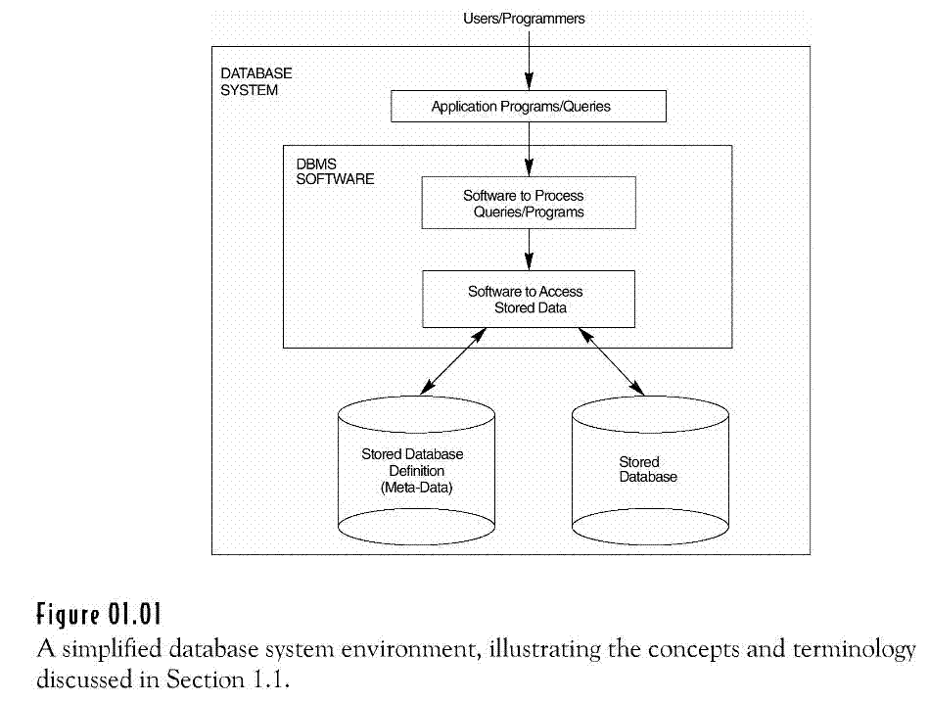
Database Management System
The database and DBMS are together called database system
Figure 1: Database Systens[1]

Slide 10
Database Management System
DBMS contains information about a particular enterprise
Collection of interrelated data
Set of programs to access the data
An environment that is both convenient and efficient to use

Slide 11
File System Databases
In the early days, database applications were built directly on top
of file systems. The programs are written time to time as per the
requirement to manipulate the data within files.
A program to debit and credit an account
A program to find the balance of an account
A program to generate monthly statements
An Example File System
A banking system may have
files for customers, saving accounts and checking accounts;
application programs to deposit and withdraw money, to find balance, etc.
different files are used for customers, saving and checking accounts

Slide 12
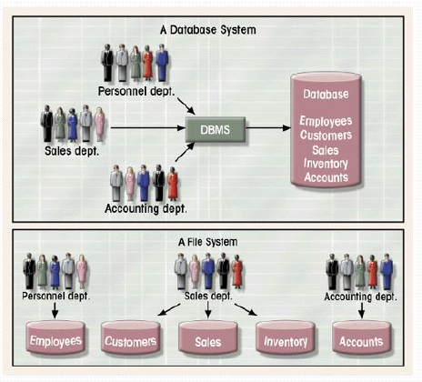
Database System vs. File Based System
Figure 2: Database System vs. File Based System[2]

Slide 13
Drawbacks of using file systems to store data
Data redundancy and inconsistency
Multiple file formats, duplication of information in different files
Difficulty in accessing data
Need to write a new program to carry out each new task
Data isolation — changes made by one operation could not become visible to other concurrent operations.
Integrity problems
Integrity constraints (e.g. account balance > 0) become “buried” in program code rather than being stated explicitly
Hard to add new constraints or change existing ones

Slide 14
File System Databases
Drawbacks of using file systems (cont.)
Atomicity of updates
Failures may leave database in an inconsistent state with partial updates carried out
Example: Transfer of funds from one account to another should either complete or not happen at all
Concurrent access by multiple users
Concurrent access needed for performance
Uncontrolled concurrent accesses can lead to inconsistencies
Example: Two people reading a balance and updating it at the same time
Security problems
Hard to provide user access to some, but not all.
Database systems offer solutions to all the above problems

Slide 15
Advantages of using the DBMS Approach
Controlling Redundancy
Restricting Unauthorized access
Proving Persistent storage for Program objects
Providing Storage Structures for efficient Query Processing
Providing backup and Recovery.
Providing multiple user interfaces
Representing Complex Relationships among data
Enforcing Integrity Constraints
Permitting Interfacing and Actions using rules
Additional advantages

Slide 16
Advantages of using the DBMS Approach
Controlling Redundancy
Redundancy means storing the same data multiple times.
Problems of redundancy :
Leads to Duplication of efforts
Wastage of storage space.
Inconsistency.
In the database approach, these redundancy problems can be removed by storing logical data items in only one place.

Slide 17
Advantages of using the DBMS Approach
Restricting Unauthorized Access
A DBMS allows only authorized users to access the database to provide the security to the database.
A DBMS controls type of access operation (retrieve and update).
A DBMS provides security and authorization subsystem for the DBA to create accounts and specify account restriction.
Providing Persistent Storage for Program Objects.
An object – oriented DBMS provides persistent storage for program objects and data structures.
e.g. :
C++ and java objects can be stored permanently so that later they can be read whenever necessary.

Slide 18
Advantages of using the DBMS Approach
Providing Storage for Structures for Efficient Query Processing.
Since database is typically stored on disk , DBMS uses index files to speed up the searching process to increase the efficiency of query processing .
It uses buffering module to maintain the records in the main memory.
The query of the DBMS is responsible for choosing an processing and optimization module efficient query execution plan for each query based on the existing storage structures.

Slide 19
Advantages of using the DBMS Approach
Providing Backup and Recovery.
The back up and recovery subsystem of the DBMS is responsible for recovery.
Providing Multiple User Interface. Theses include
query languages for users
APIs (Application Programming Interface) for application programmers
Forms and command codes for parametric users.
Menu Driven interfaces for stand-alone programmers

Slide 20
Advantages of using the DBMS Approach
7. Representing complex Relationship among Data.
A DBMS has the capability to represent a variety of complex relationships among the data as well as to retrieve and update related data easily and efficiently.
8. Enforcing Integrity Constraints.
A DBMS provides capabilities for defining and enforcing Integrity constraints.
Two types of constraints :
Simple type of integrity constraints
e.g : month must be an integer between 1 - 12
complex type of integrity constraints
e.g. a section record must be related to course record.

Slide 21
Advantages of using the DBMS Approach
Permitting Inferencing and Actions Using Rules :
Some database systems provide capabilities for defining deduction rules for inferencing new information from the stored database facts. Such systems are called deductive database systems.
Active database systems provide active rules that can automatically initiate actions when certain events and conditions occur.
Additional advantages :
Potential for enforcing standards
Reduced Application Development Time
Flexibility
Availability of up-to-Date information.

Slide 22
Data Models
Data Abstraction is provided by a Data Model. It is a collection of tools for describing following:
Data
Data relationships
Data semantics (study of meaning)
Data constraints (restrictions/rules)
OR
A collection of concepts that can be used to describe the structure of database.
Structure of database means → the data types , relationships and constraints on the data.
A data model may also include operations for retrieval and updates on the database.
A set of valid user defined operation can also be specified in a Data Model

Slide 23
Data Models - Types
Relational model
Entity-Relationship data model (mainly for database design)
Object-based data models (Object-oriented and Object-relational)
Semi-structured data model (XML)
Other older models:
Network model
Hierarchical model

Slide 24
Relational Model
Relational Model was proposed by E.F. Codd to model data in the form of relations or tables.
Relational Model represents how data is stored in Relational Databases.
A relational database stores data in the form of relations (tables).
Consider a relation STUDENT with attributes ROLL_NO, NAME, ADDRESS, PHONE and AGE shown in Table.
ROLL_NO | NAME | ADDRESS | PHONE | AGE
1 | RAM | DELHI | 9455123451 | 18
2 | RAMESH | GURGAON | 9652431543 | 18
3 | SUJIT | ROHTAK | 9156253131 | 20

Slide 25
IMPORTANT TERMINOLOGIES
Attribute: Attributes are the properties that define a relation. e.g.; ROLL_NO, NAME
Tuple: Each row in the relation is known as tuple. e.g. 1 RAM DELHI 9455123451 18. Each row in a tuple is a record.
ROLL_NO | NAME | ADDRESS | PHONE | AGE
1 | RAM | DELHI | 9455123451 | 18
2 | RAMESH | GURGAON | 9652431543 | 18
3 | SUJIT | ROHTAK | 9156253131 | 20

Slide 26
Reference Books
1. Henry F Korth, Abraham Silberschatz, S. Sudurshan, Database system concepts, 5th Edition, McGraw-Hill,2006
2. Database Systems: Design, Implementation, and Management, 9th Edition, Coronel, Moris and Rob, 2011
3. Ramez Elmasri , Shamkant B. Navathe , Fundamentals of Database Systems, 4th Edition, Pearson Education, 2006.
4. Ramakrishnan, Gehrke, Database Management Systems, Mcgraw-Hill, 3rd Edition, Addison-Wesley,2006.
5. Thomas Connolly, Carolyn Begg, Database Systems-A Practical Approach to design, Implementation and Management, 3rd Edition, Addison-Wesley,2002.

Slide 27
Thank you

